Slide 1
Logic Gates
'='

Slide 2

Learning Objectives
In
this chapter you will learn about:
Logic Gate
Logic circuits and Boolean expressions
Combinational circuits and design

Slide 3
Logic Gates
• Logic
gates are
electronic
circuits
that
operate
on
one or more input signals to produce standard output
signal
• Are
the building blocks of all
the
circuits
in
a
computer
• Some of the most basic and useful
logic
gates
are
AND,
OR,
NOT,
NAND
and
NOR
gates

Slide 4
AND Gate
(Block
Table)
Diagram
Symbol
and
Truth
A
B
C
=
B
A
Inputs
Output
A
B
C = A B
0
0
0
0
1
0
1
0
0
1
1
1

Slide 5
OR Gate (Block Diagram
Symbol
and
Truth
Table)
A
B
C
=
A
+
B
Inputs
Output
A
B
C = A + B
0
0
0
0
1
1
1
0
1
1
1
1

Slide 6
NOT Gate (Block Diagram
Symbol
and
Truth
Table)
A
A
Input
Output
A
A
0
1
1
0

Slide 7
Finding Boolean Expression
of
a
Logic
Circuit
(Example
1)
A
A
NOT
D= A.
B +
C
B + C
B
C
AND
OR

Slide 8
Finding Boolean Expression
of
a
Logic Circuit
(Example
2)
OR
A
B
A+
B
C=
A + B.
A
B
A B
A
B
AND
AND
NOT

Slide 9
Constructing a Logic Circuit from
Expression (Example 1)
a
Boolean
Boolean
Expression =
A
B +C
AND
A
B
A
B
A
B +C
C
OR

Slide 10
Implementing a Boolean
NAND Gates (Example)
Expression with
Only
Boolean
Expression
=
A
B
+ C
(A + B D)
A
A B
A
B
+ C
(A
+ B
D)
B
B
D A
C
B
D
A +B
D
C (A +B D)
(a)
Step 1:
AND/OR implementation
(Continued on next slide)

Slide 11
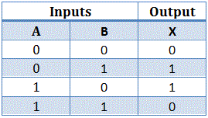
Exclusive-OR Function
A
+
B
= A
B
+
A
B
A B
C = A
B = A
B + A B
+

Slide 12
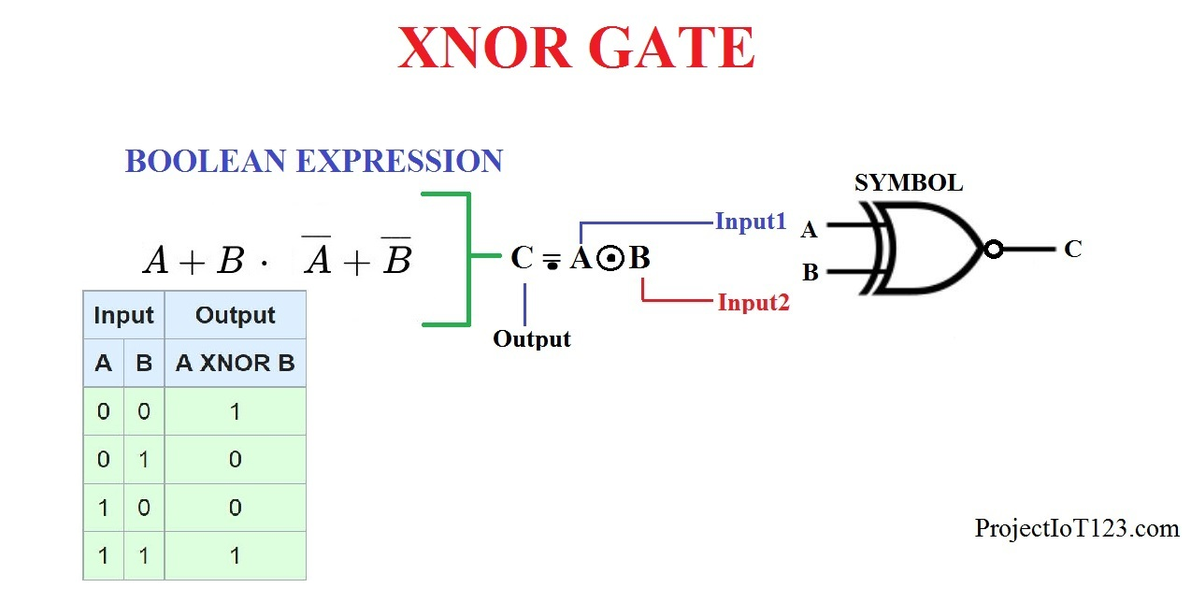
Exclusive-OR Function

Slide 13
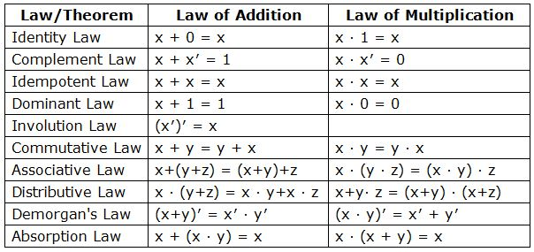
Boolean Function Simplification Rules

Slide 14
Thank You

